Slide 1
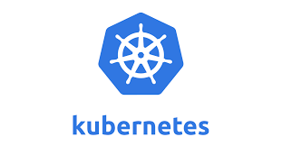

Slide 2
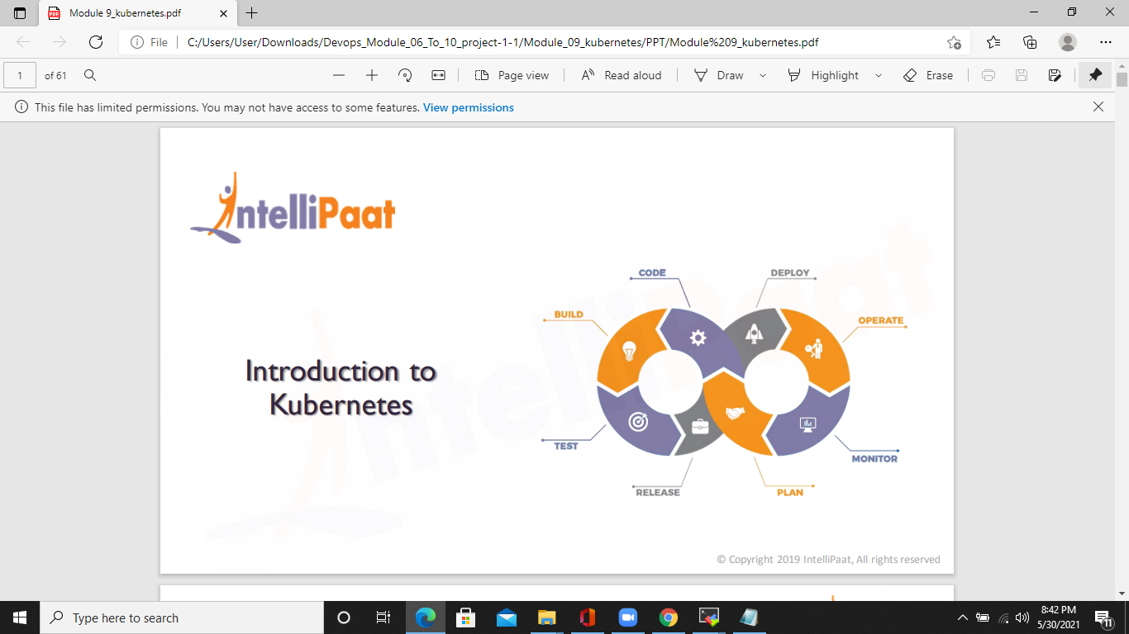

Slide 3
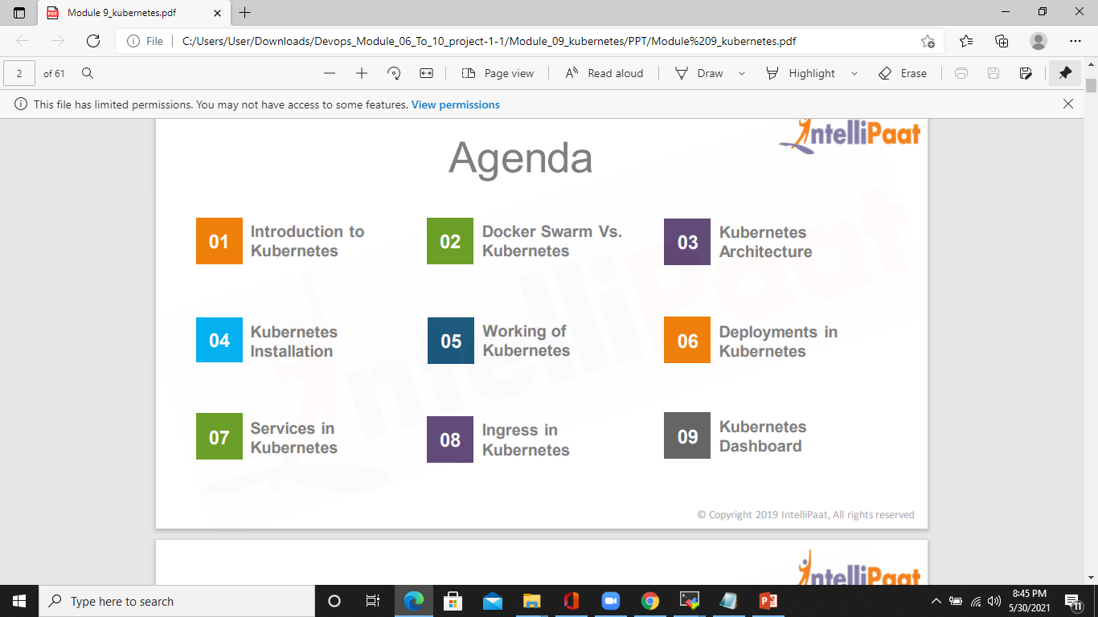
AGENDA

Slide 4
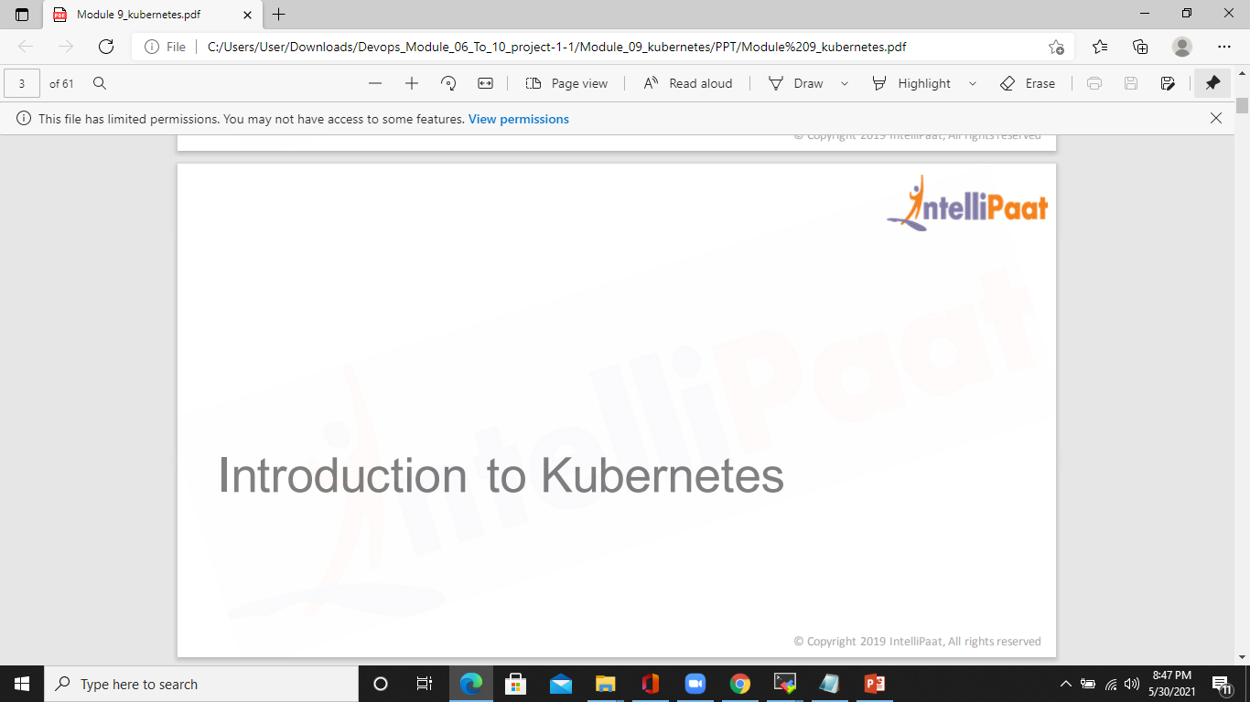

Slide 5
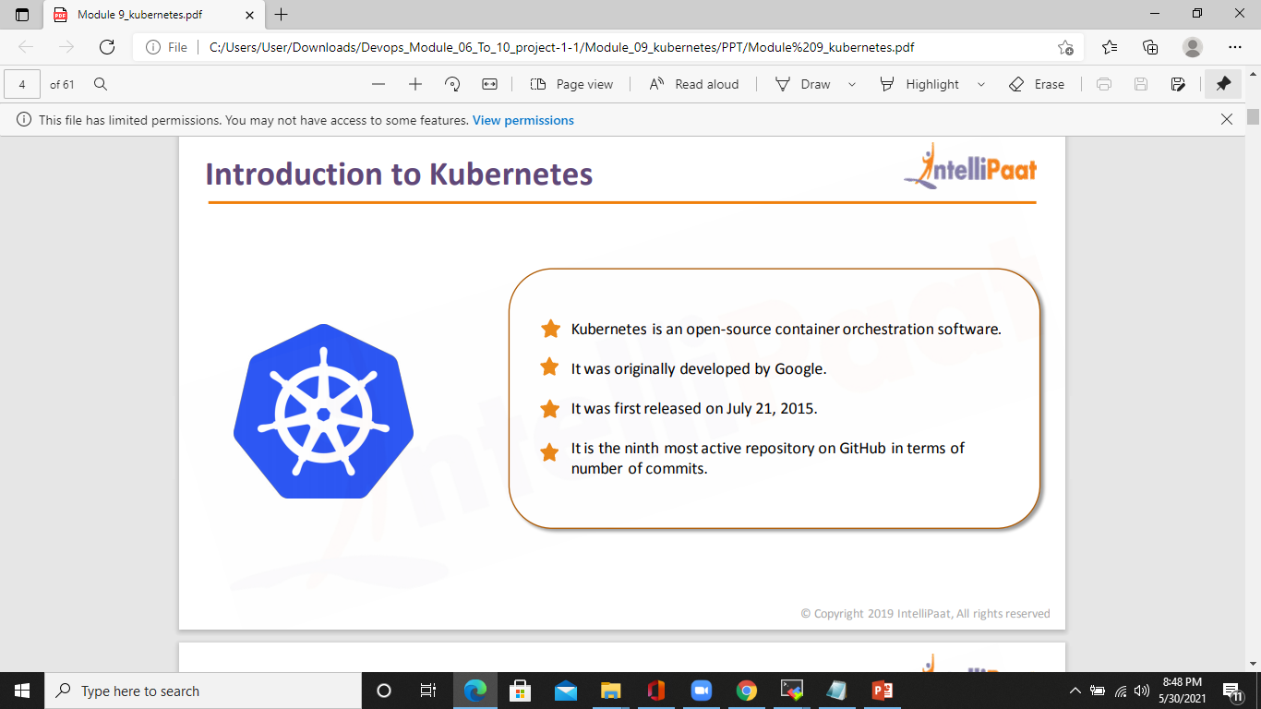
Introduction to kubernetes

Slide 6
What is Kubernetes?
Kubernetes is also known as 'k8s'. This word comes from the Greek language, which means a pilot or helmsman.
Kubernetes is an extensible, portable, and open-source platform designed by Google in 2014. It is mainly used to automate the deployment, scaling, and operations of the container-based applications across the cluster of nodes. It is also designed for managing the services of containerized apps using different methods which provide the scalability, predictability, and high availability.
It is actually an enhanced version of 'Borg' for managing the long-running processes and batch jobs. Nowadays, many cloud services offer a Kubernetes-based infrastructure on which it can be deployed as the platform-providing service. This technique or concept works with many container tools, like docker, and follows the client-server architecture.

Slide 7
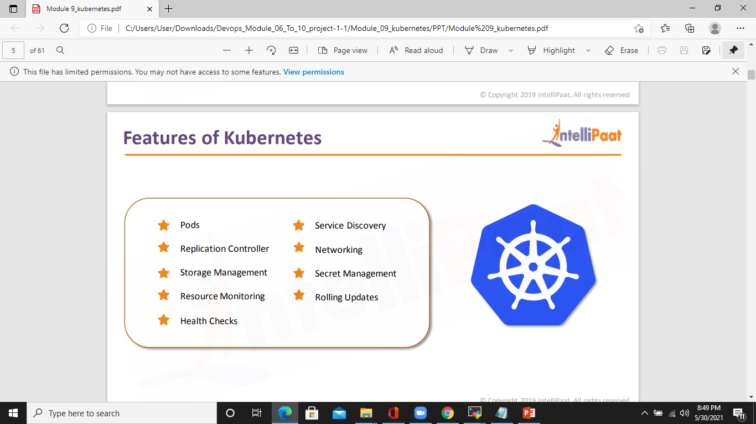
Features of kubernetes

Slide 8
KUBERNETES KEY OBJECTS
POD
It is the smallest and simplest basic unit of the Kubernetes application. This object indicates the processes which are running in the cluster.
Node
A node is nothing but a single host, which is used to run the virtual or physical machines. A node in the Kubernetes cluster is also known as a minion.
Service
A service in a Kubernetes is a logical set of pods, which works together. With the help of services, users can easily manage load balancing configurations.
ReplicaSet
A ReplicaSet in the Kubernetes is used to identify the particular number of pod replicas are running at a given time. It replaces the replication controller because it is more powerful and allows a user to use the "set-based" label selector.

Slide 9
Namespaces
Kubernetes supports various virtual clusters, which are known as namespaces. It is a way of dividing the cluster resources between two or more users.

Slide 10
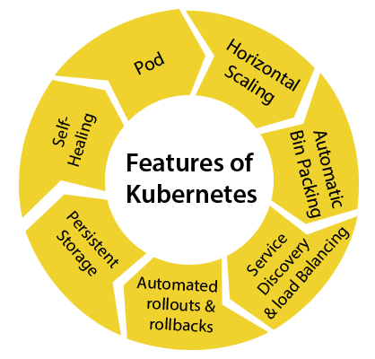
Features of kubernetes

Slide 11
Features of kubernetes
Pod: It is a deployment unit in Kubernetes with a single Internet protocol address.
Horizontal Scaling: It is an important feature in the Kubernetes. This feature uses a HorizontalPodAutoscalar to automatically increase or decrease the number of pods in a deployment, replication controller, replica set, or stateful set on the basis of observed CPU utilization.
Automatic Bin Packing: Kubernetes helps the user to declare the maximum and minimum resources of computers for their containers.
Service Discovery and load balancing: Kubernetes assigns the IP addresses and a Name of DNS for a set of containers, and also balances the load across them.
Automated rollouts and rollbacks: Using the rollouts, Kubernetes distributes the changes and updates to an application or its configuration. If any problem occurs in the system, then this technique rollbacks those changes for you immediately.
Persistent Storage: Kubernetes provides an essential feature called 'persistent storage' for storing the data, which cannot be lost after the pod is killed or rescheduled. Kubernetes supports various storage systems for storing the data, such as Google Compute Engine's Persistent Disks (GCE PD) or Amazon Elastic Block Storage (EBS). It also provides the distributed file systems: NFS or GFS.
Self-Healing: This feature plays an important role in the concept of Kubernetes. Those containers which are failed during the execution process, Kubernetes restarts them automatically. And, those containers which do not reply to the user-defined health check, it stops them from working automatically.

Slide 12
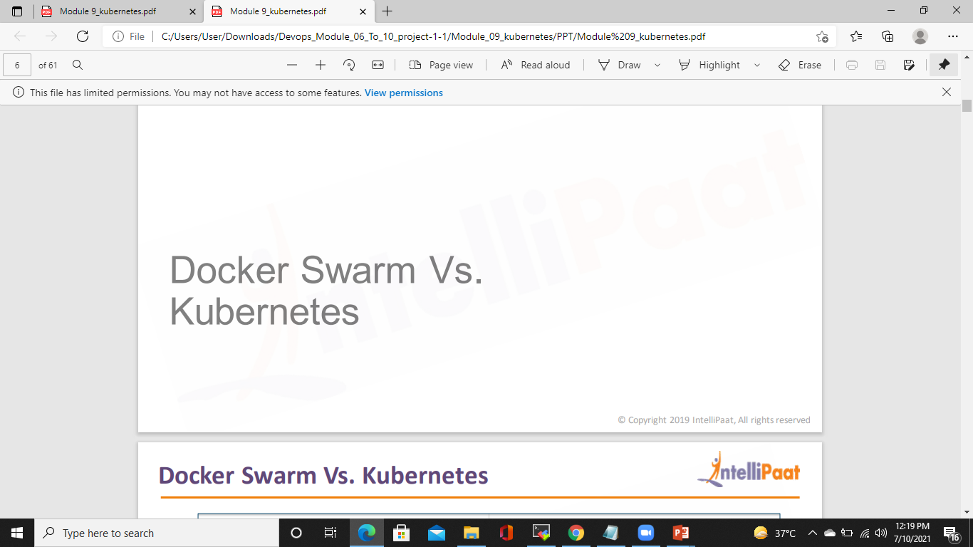
Docker SWARM VS KUBERNETES

Slide 13
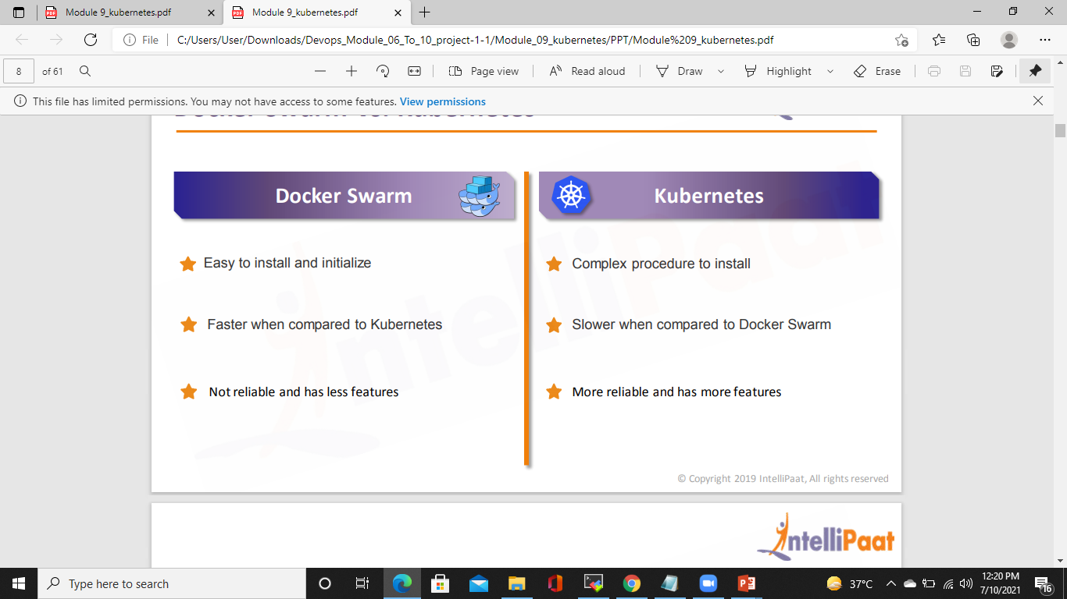
Docker SWARM VS KUBERNETES

Slide 14
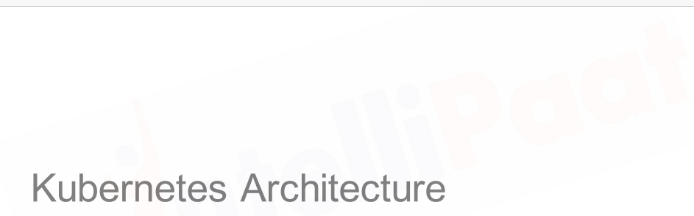
Kubernetes architecture

Slide 15
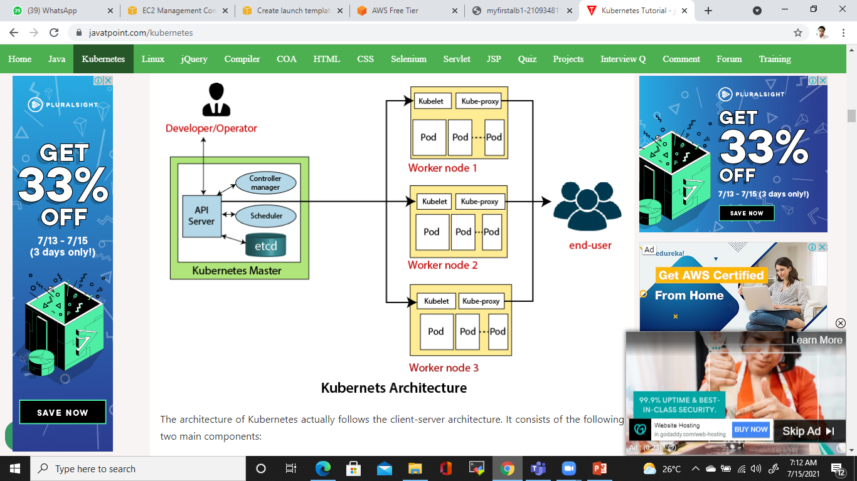
Kubernetes architecture

Slide 16
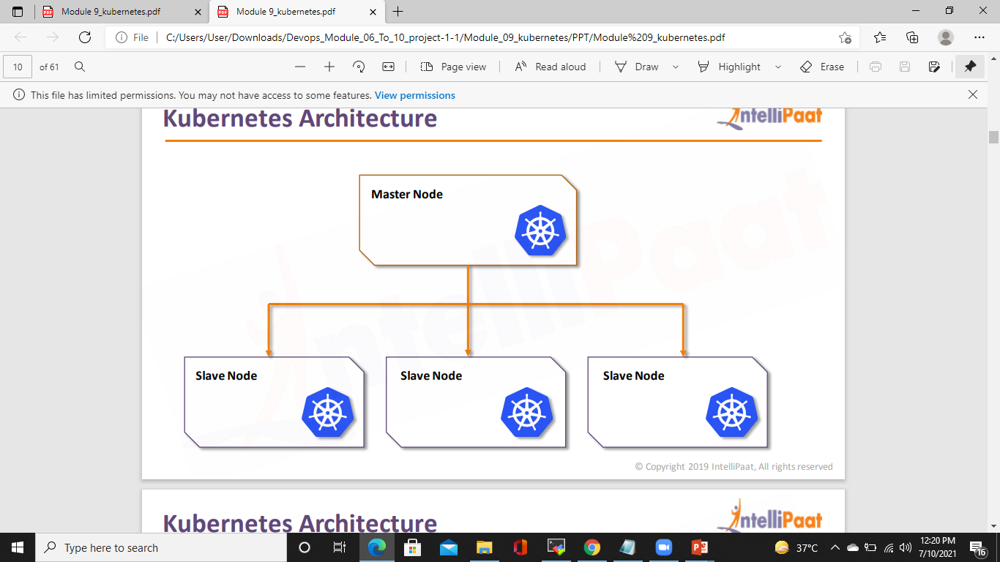
Kubernetes architecture

Slide 17
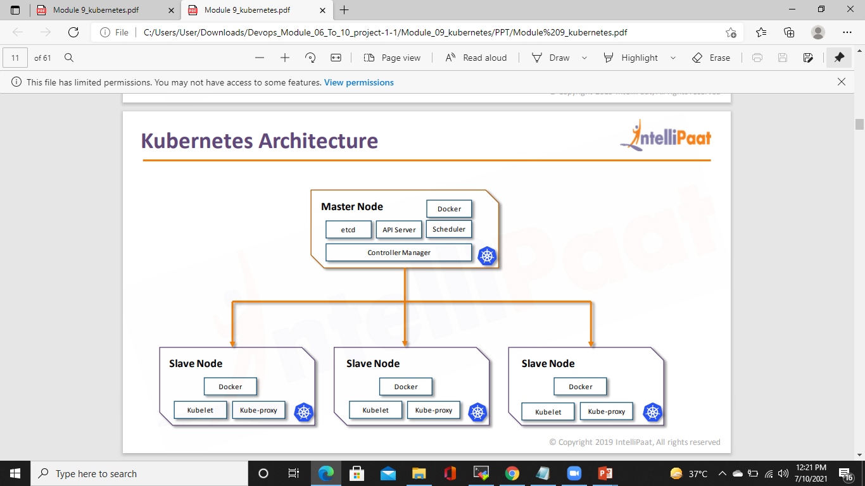
Kubernetes architecture

Slide 18
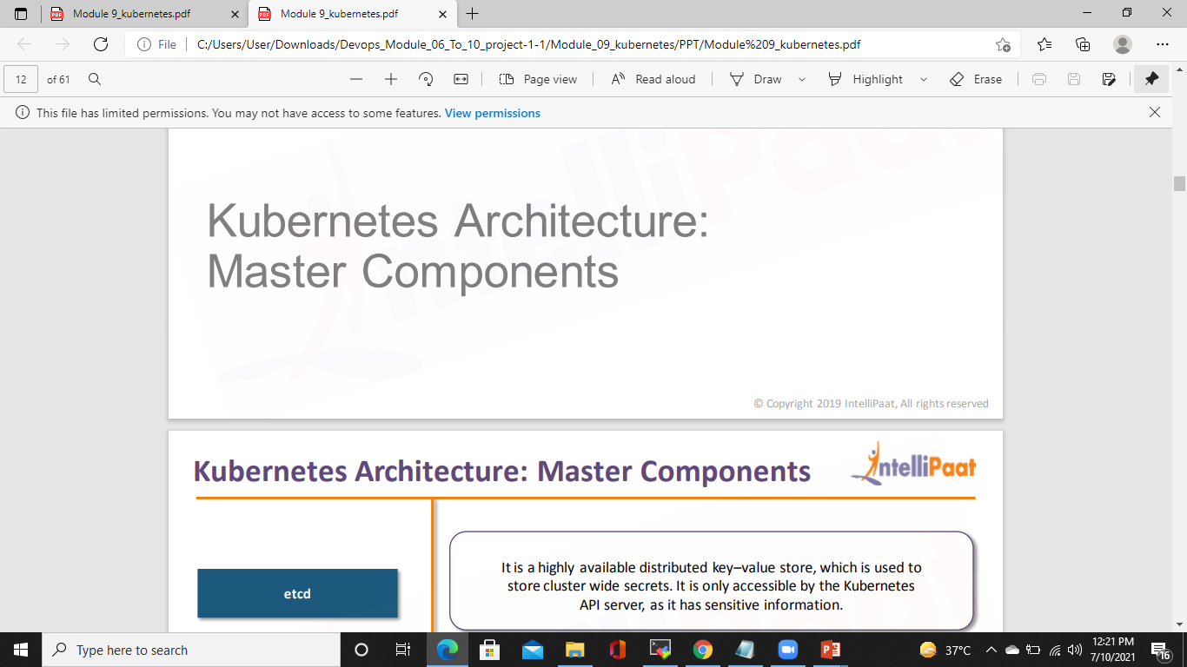

Slide 19
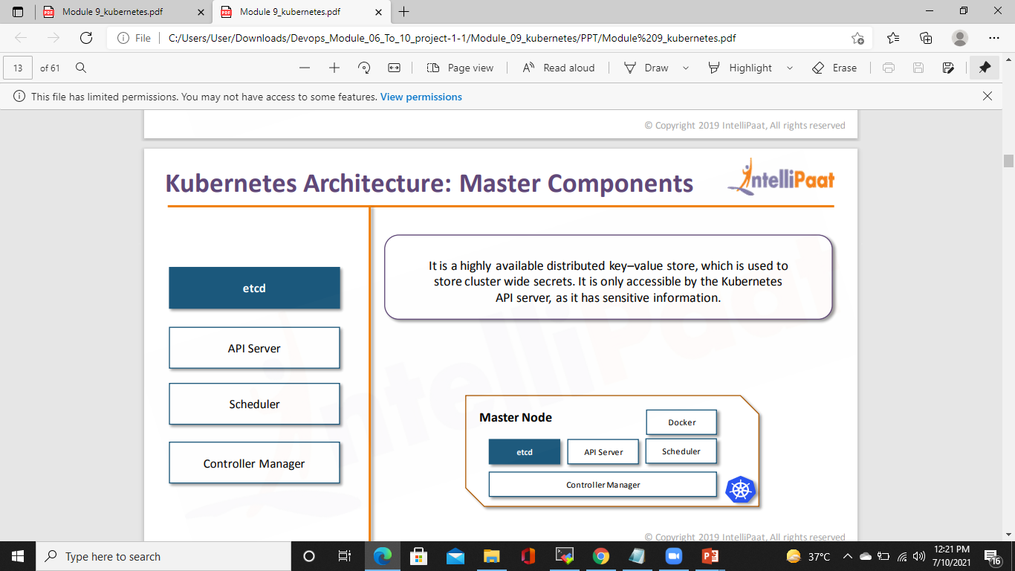
Kubernetes architecture: MASTER COMPONENTS

Slide 20
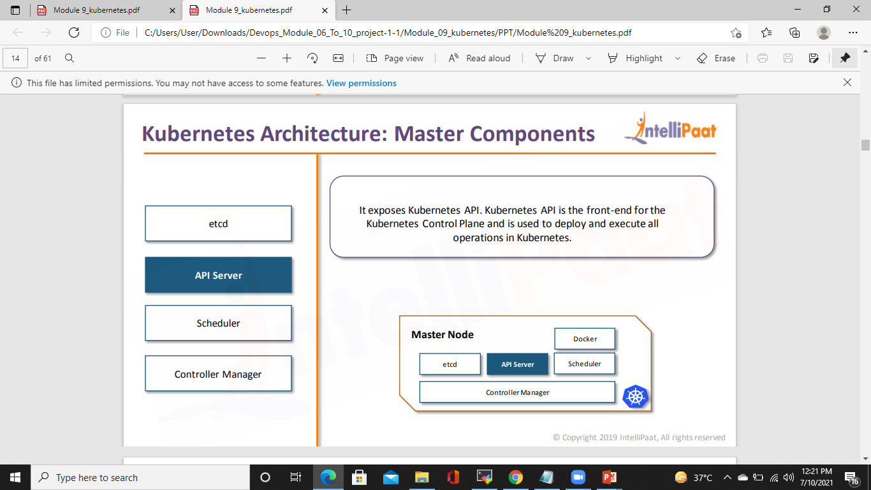
Kubernetes architecture: MASTER COMPONENTS

Slide 21
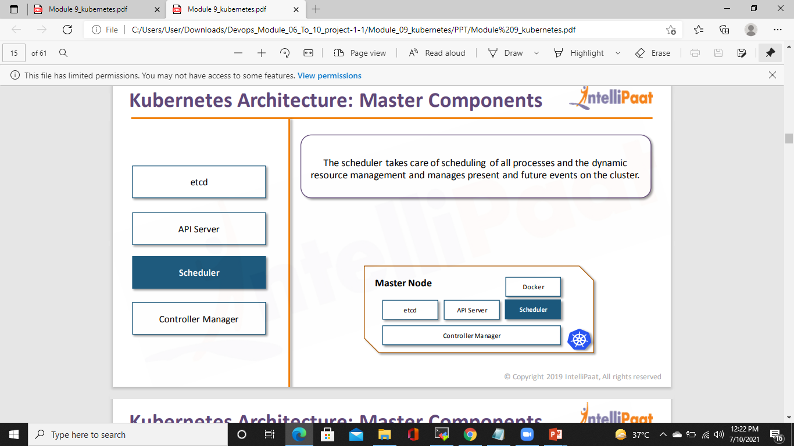
Kubernetes architecture: MASTER COMPONENTS

Slide 22
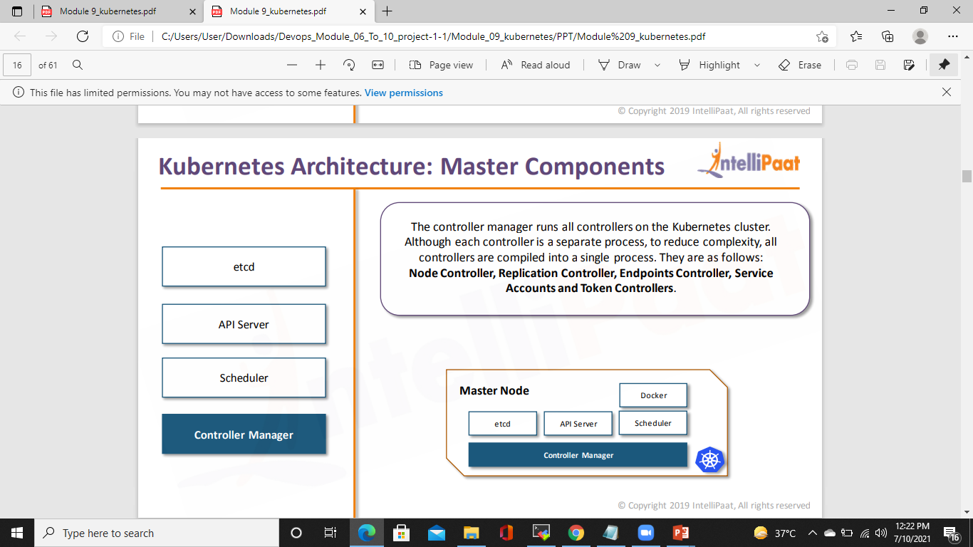
Kubernetes architecture: MASTER COMPONENTS

Slide 23
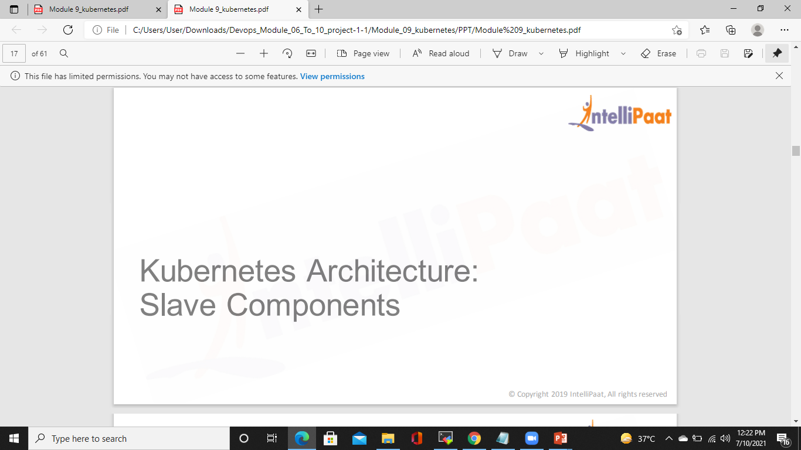
Kubernetes architecture: SLAVE COMPONENTS

Slide 24
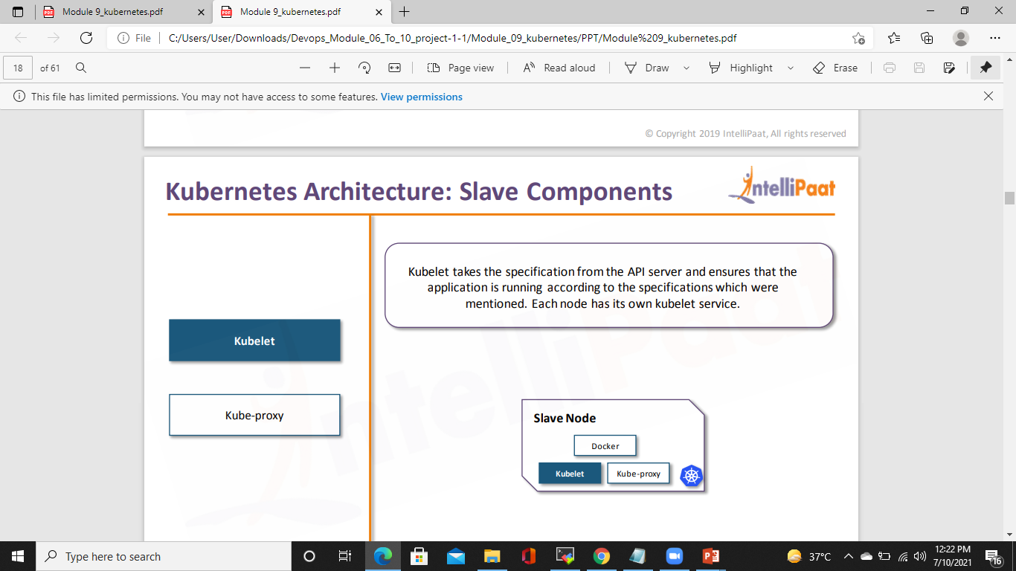
Kubernetes architecture: SLAVE COMPONENTS

Slide 25
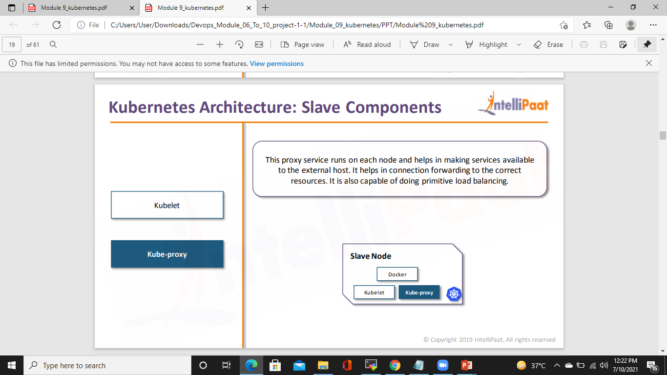
Kubernetes architecture: SLAVE COMPONENTS

Slide 26
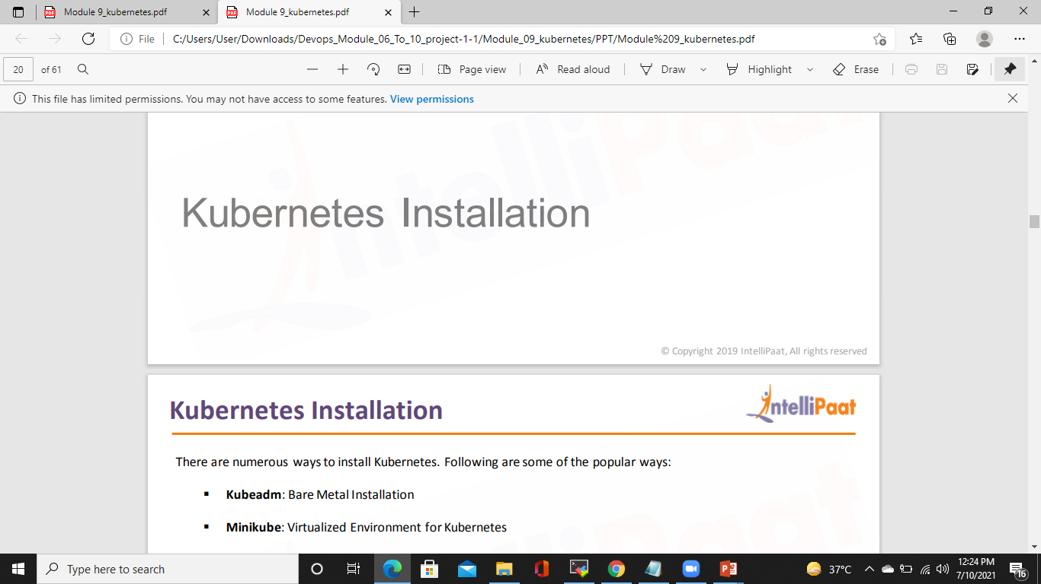
Kubernetes Installation

Slide 27
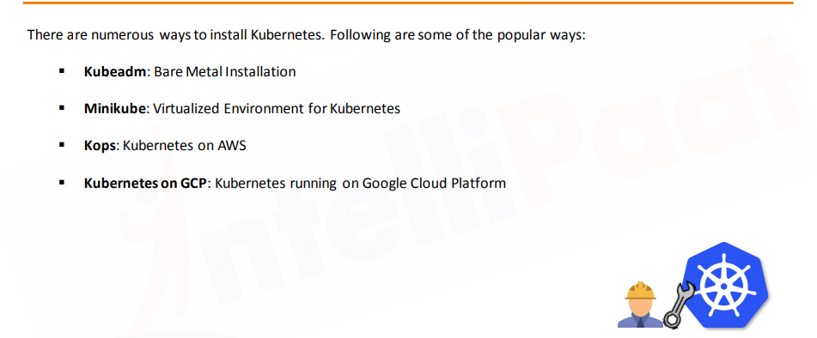
Kubernetes Installation

Slide 28
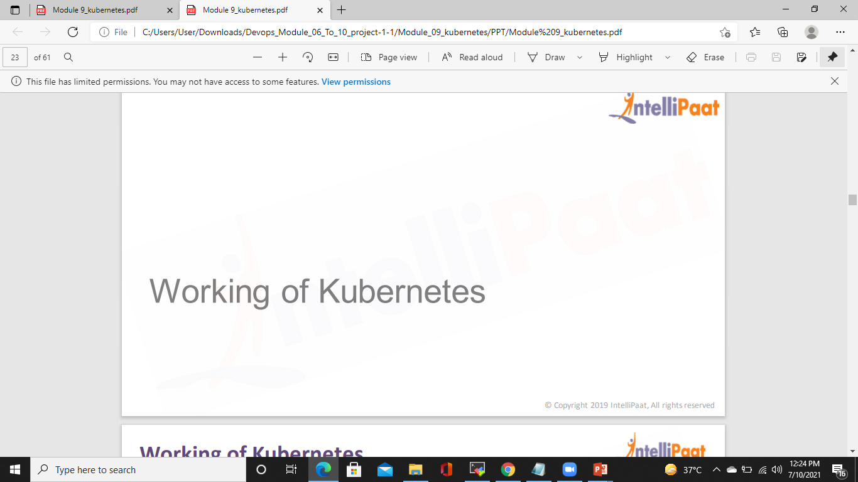
Working of Kubernetes

Slide 29
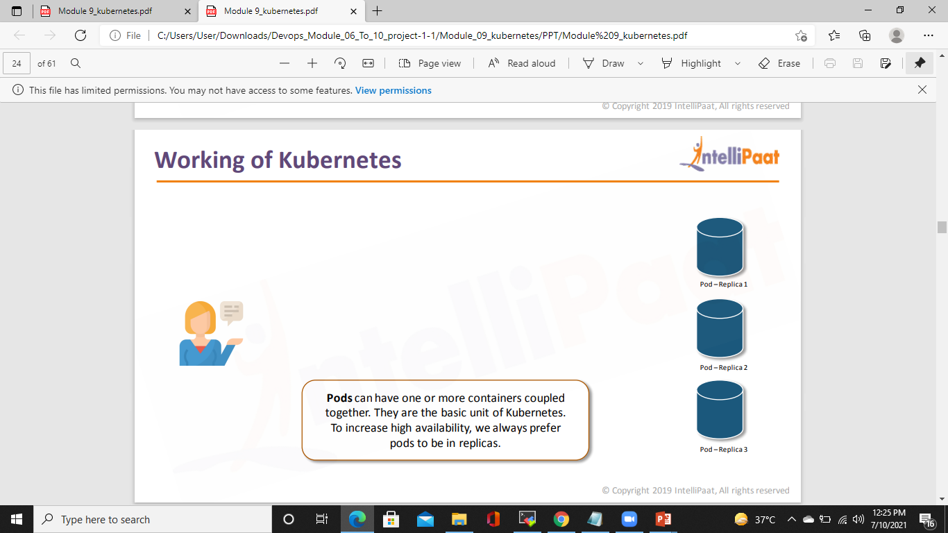
Working of Kubernetes

Slide 30
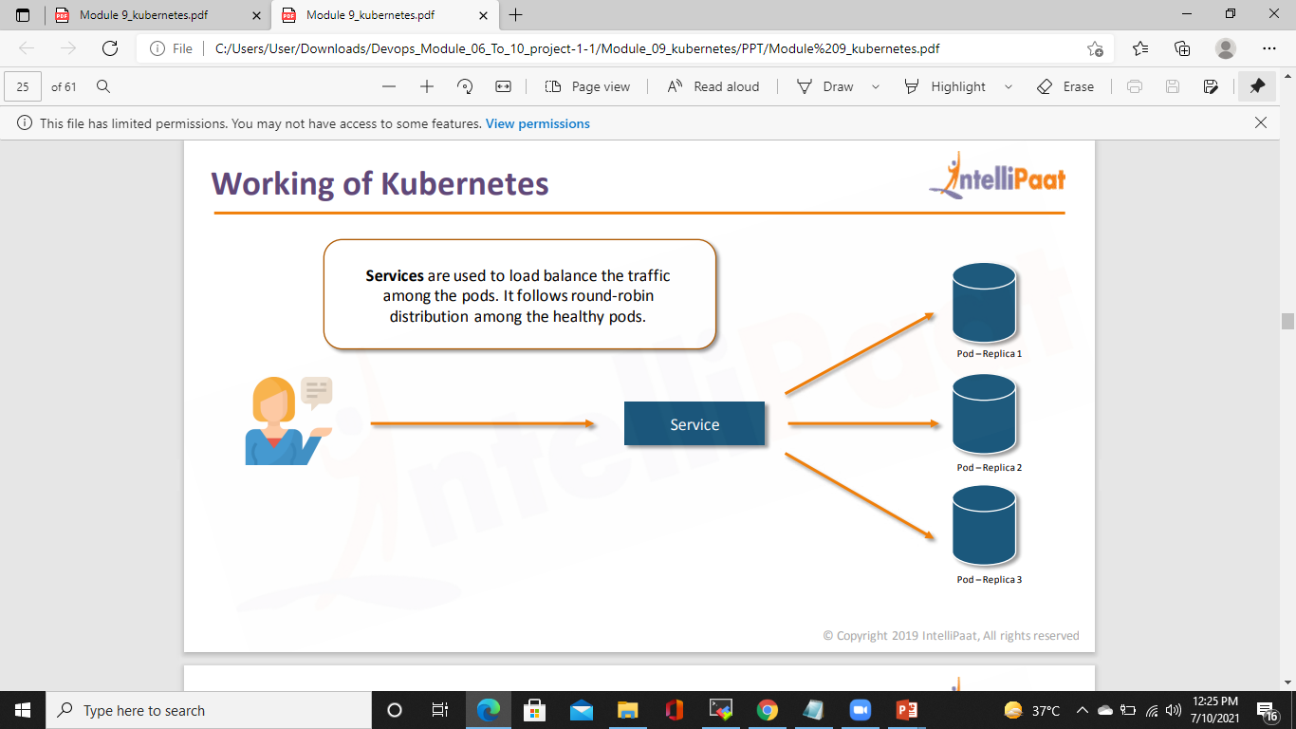
Working of Kubernetes

Slide 31
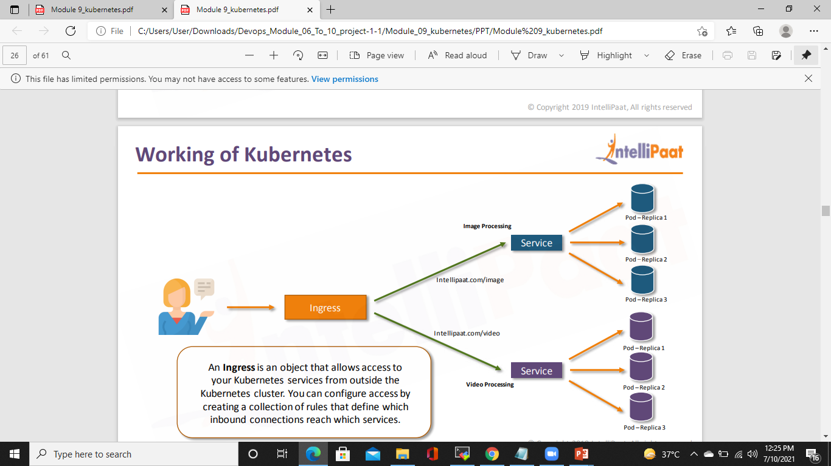
Working of Kubernetes

Slide 32
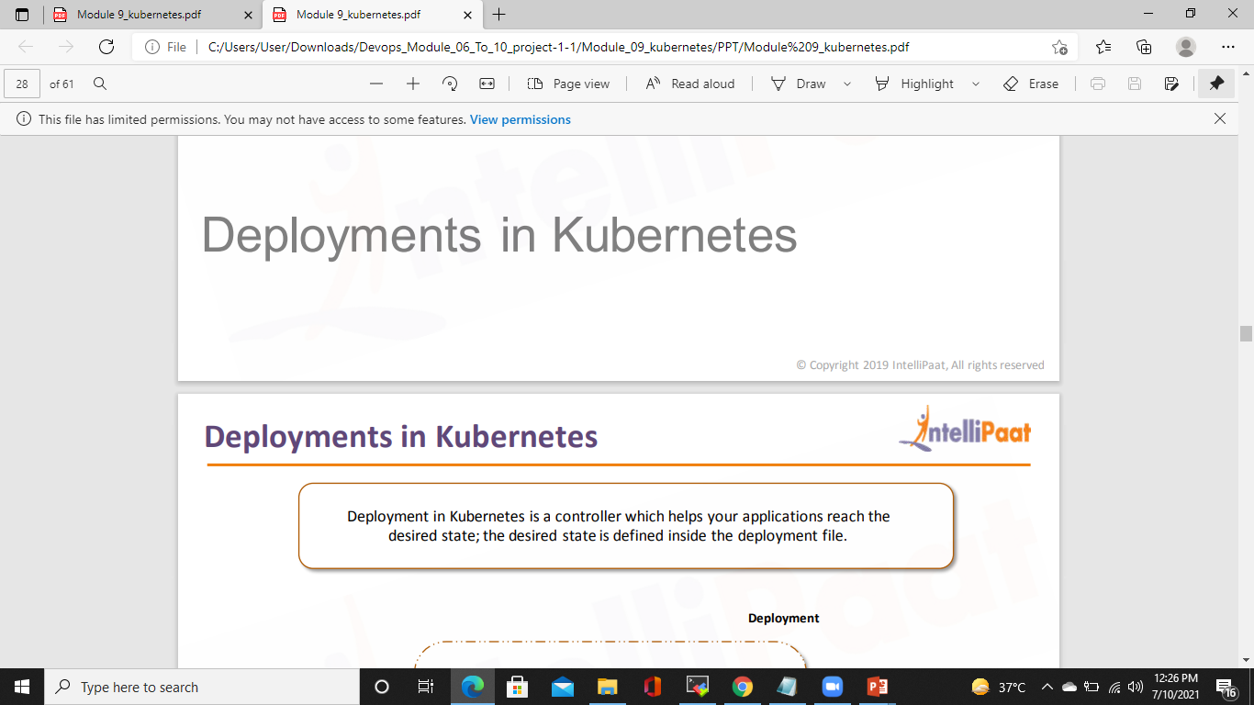
Deployments in kubernetes

Slide 33
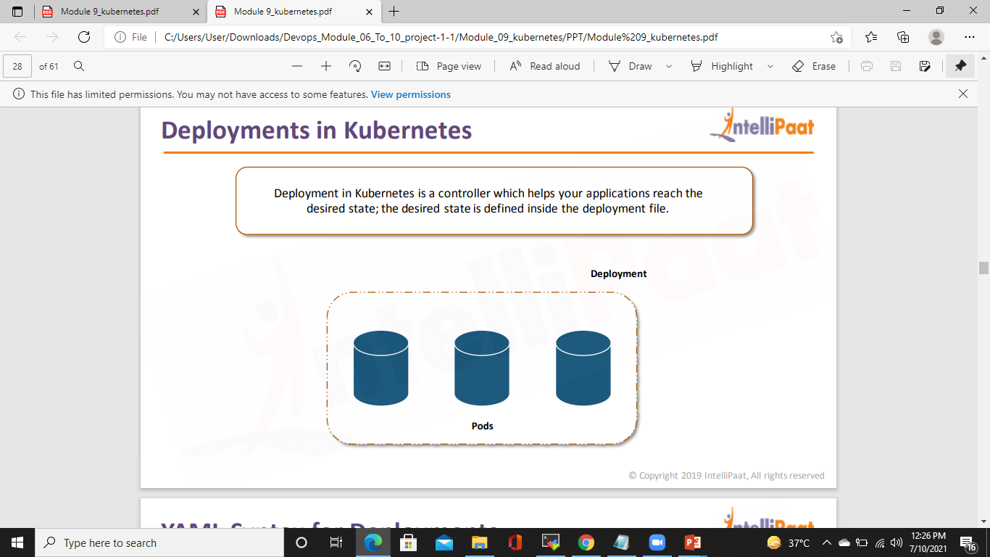
Deployments in kubernetes

Slide 34
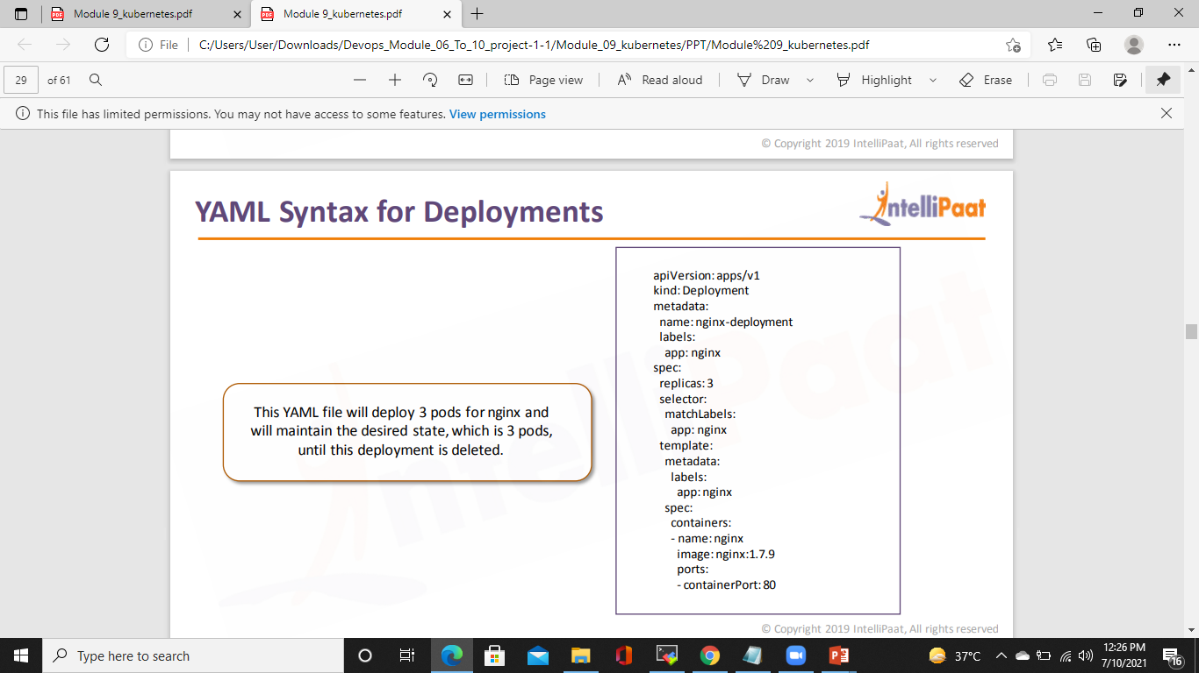
YAML Syntax for Deployments

Slide 35
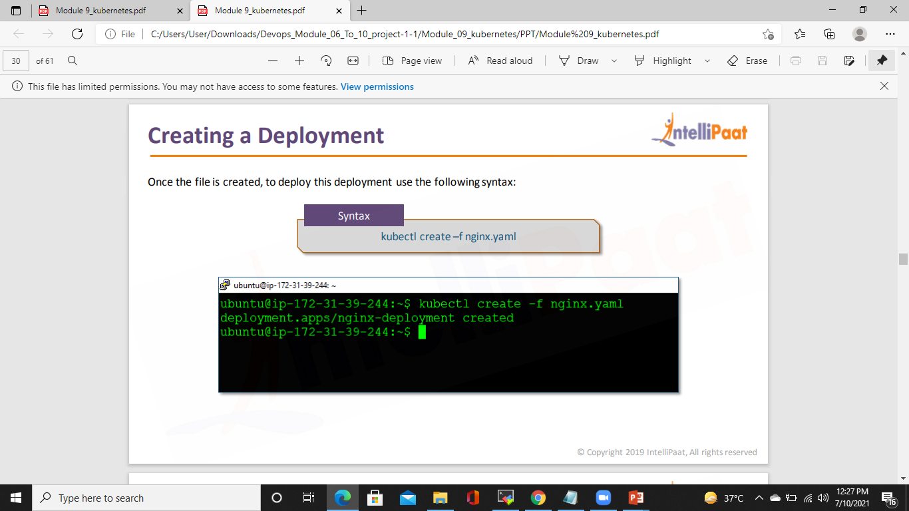
Creating a DePLOYMNET

Slide 36
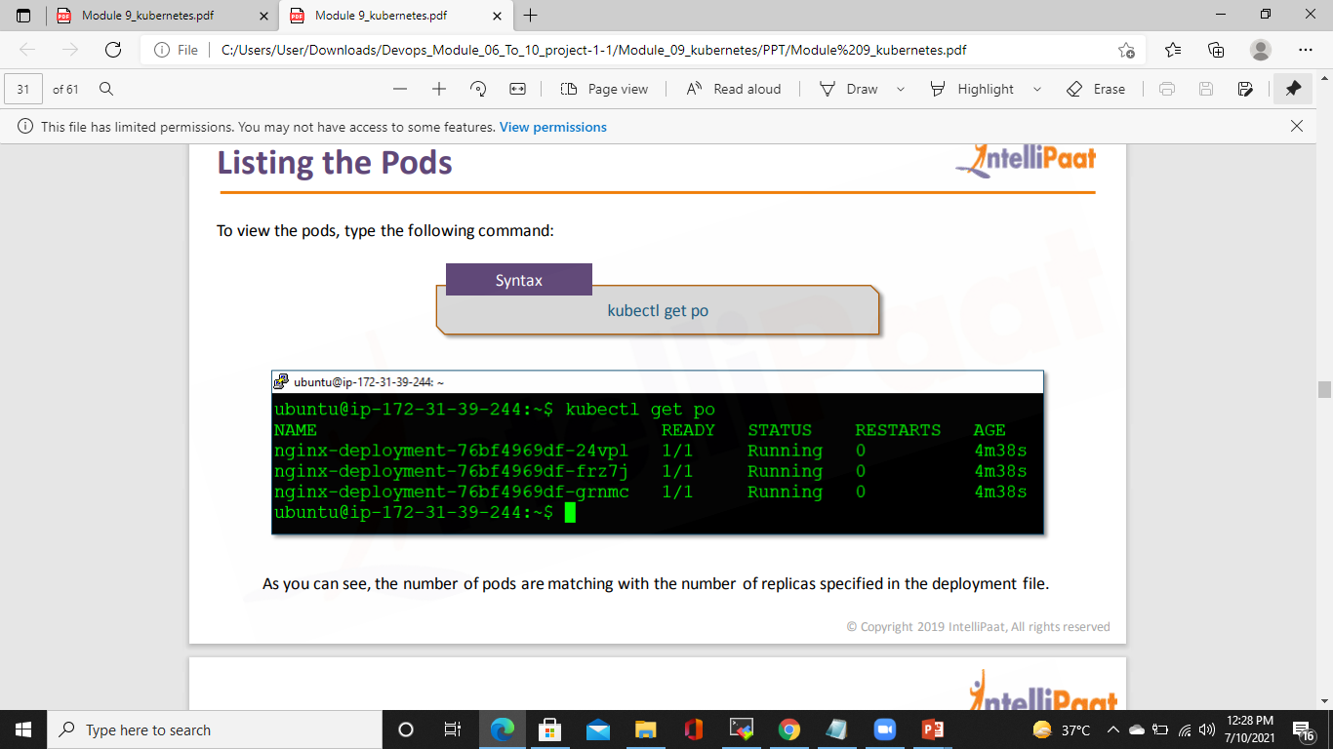
LISTING THE PODS

Slide 37
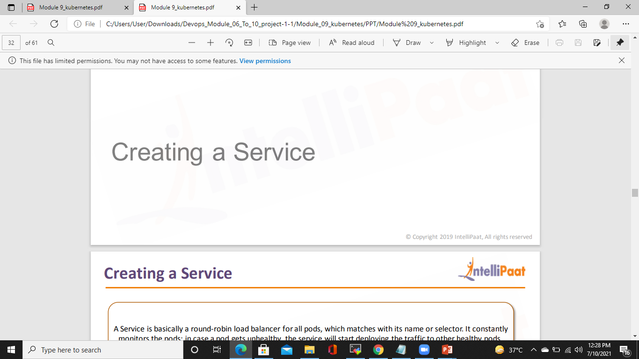
CREATING A SERVICE

Slide 38
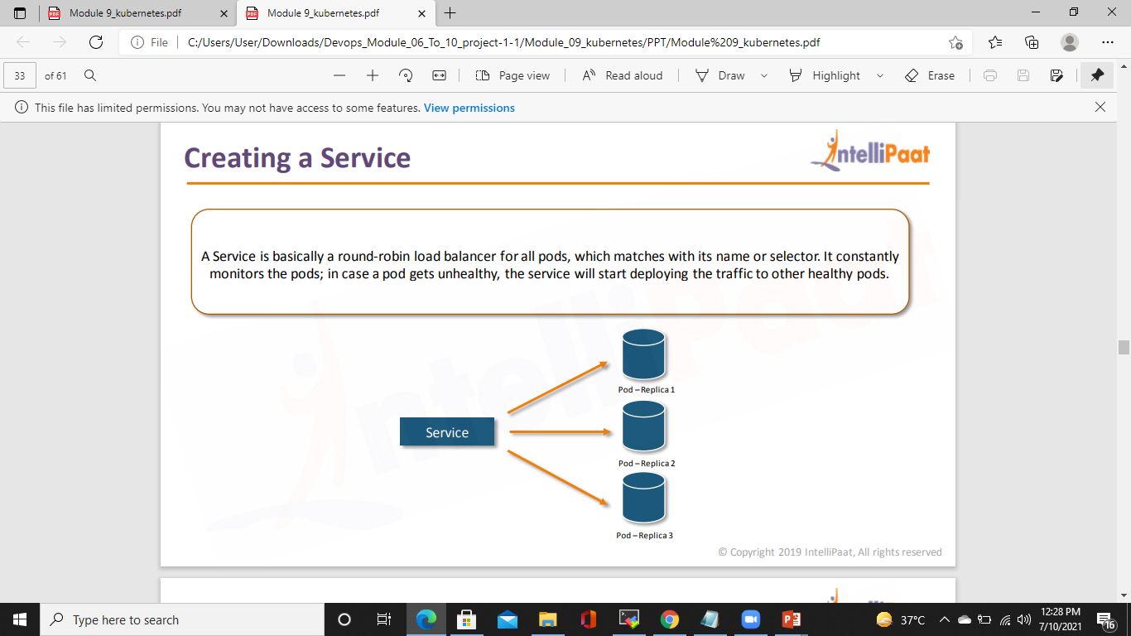
CREATING A SERVICE

Slide 39
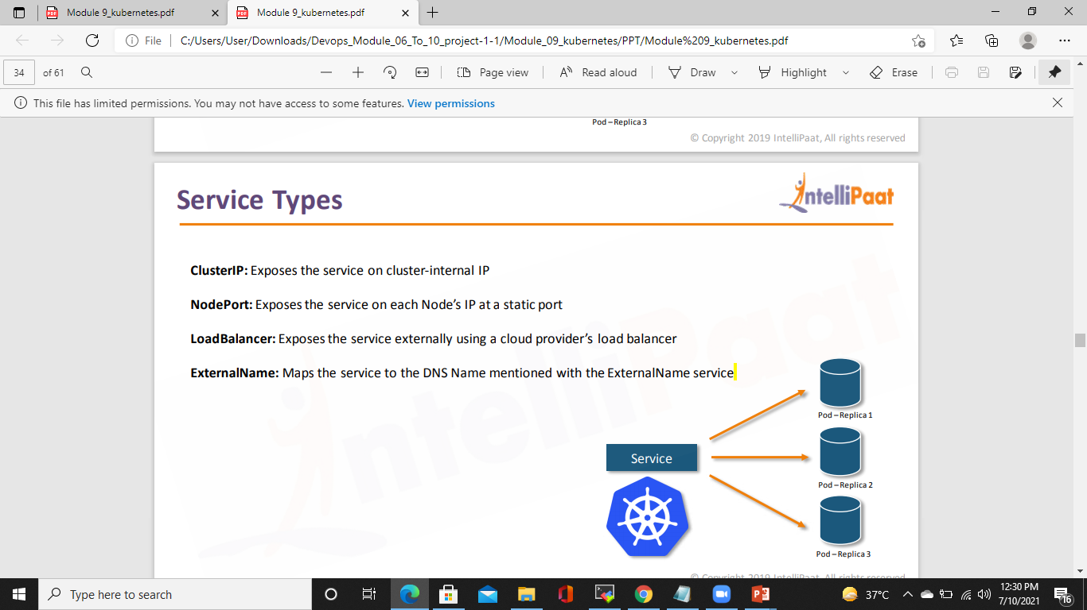
SERVICE TYPES

Slide 40
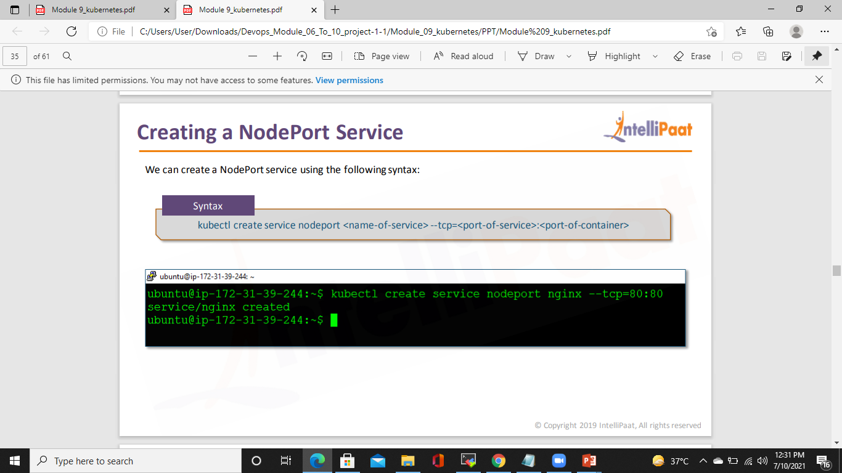
Creating A Nodeport service

Slide 41
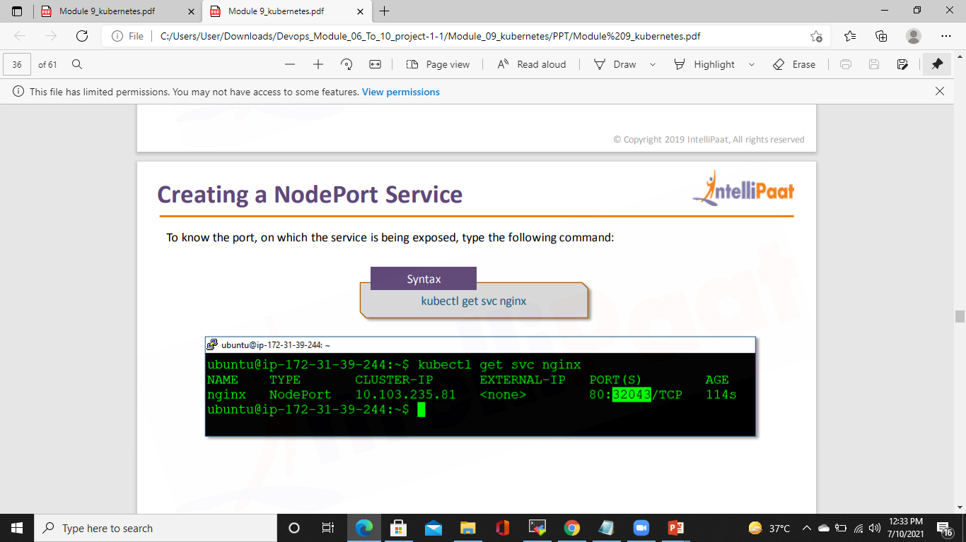
CREATING A NODEPORT SERVICE

